Slide 1
Fake Detect

Slide 2
Obama Dataset
 | # of Videos | Video Length (s) | Total # of Frames
Pristine Obama Videos (Train Positive) | 80 | 7118 | 207994
Pristine Others’ Videos (Train Negative) | 500 | 6335 | 184116
Pristine Obama Videos (Test Positive) | 76 | 6720 | 196541
Generated Face-swap Video (Test Negative) | 117 | 2791 | 283916
Impersonator Video (Test Negative) | 2 | 417 | 12707
Other Politicians’ Video (Test Negative) | 50 | 15561 | 456449
Trump
 | # of Videos | Video Length (s) | Total # of Frames
Pristine Trump Videos (Train Positive) | 14 | 1207 | 35257
Pristine Others’ Videos (Train Negative) | 197 | 3681 | 101819
Pristine Obama Videos (Test Positive) | 12 | 1027 | 23838
Generated Face-swap Video (Test Negative) | 73 | 1184 | 121328
Other Politicians’ Video (Test Negative) | 50 | 15561 | 456449

Slide 3
Feature Analysis Test Negative: generated fake videos [FaceSwap using targets’ masks]
Sequence = 100 Frame, Overlap = 10 Frame
 | Trump | Obama
All Feature | 0.658025 | 0.30054
Location of the head wrt camera | 0.676117 | 0.29845
Head rotation | 0.819682 | 0.465786
Lip gap/width | 0.984704 | 0.992473
Eye gaze direction | 0.682071 | 0.892383
Eye blink | 0.703402 | 0.875203

Slide 4
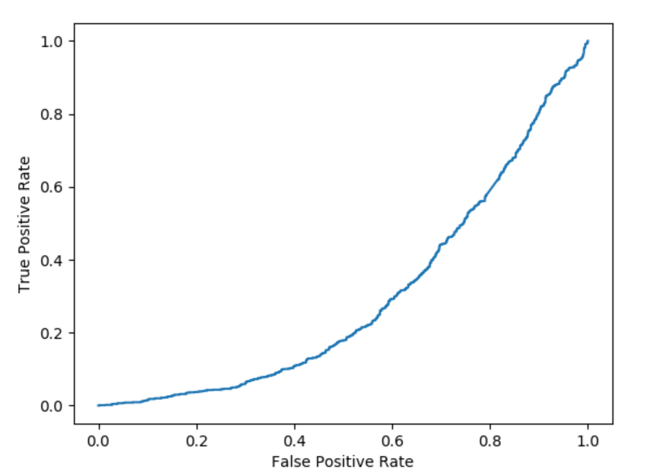
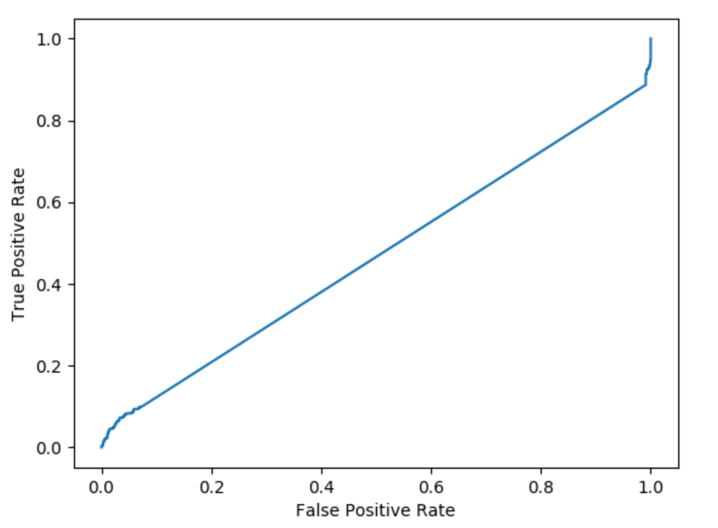
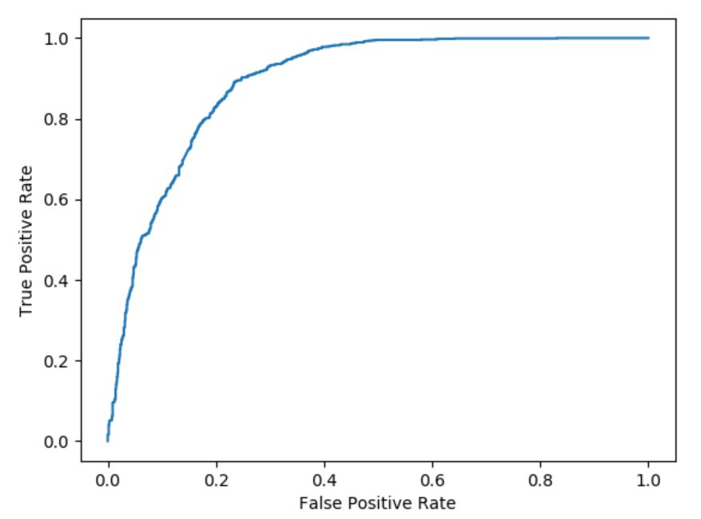
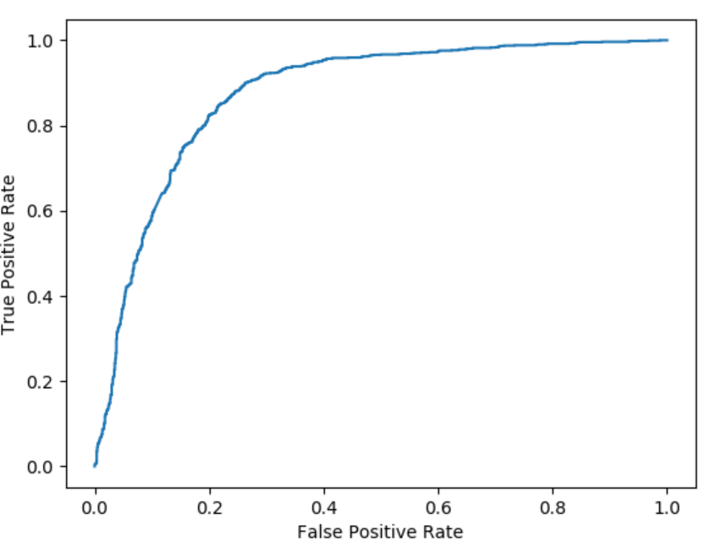
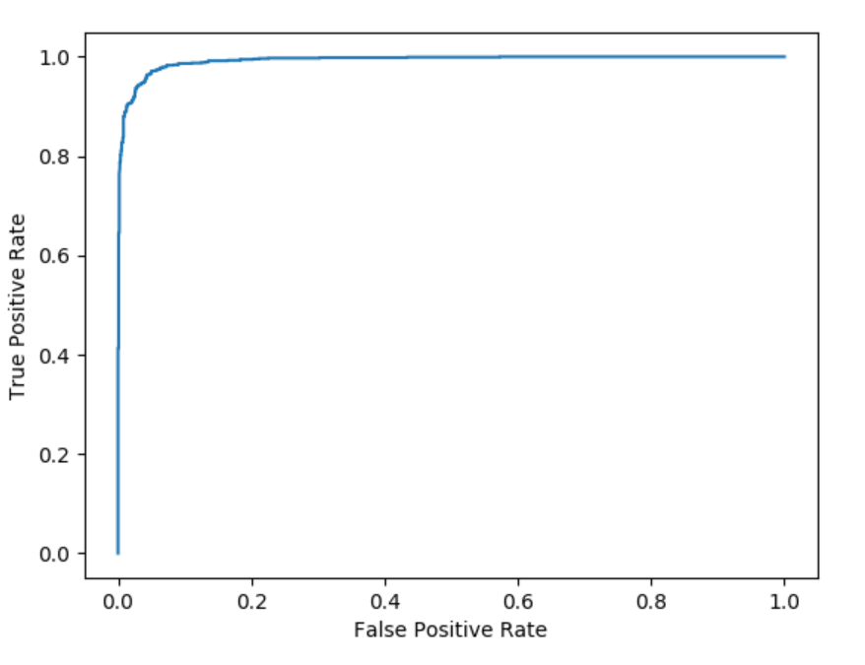
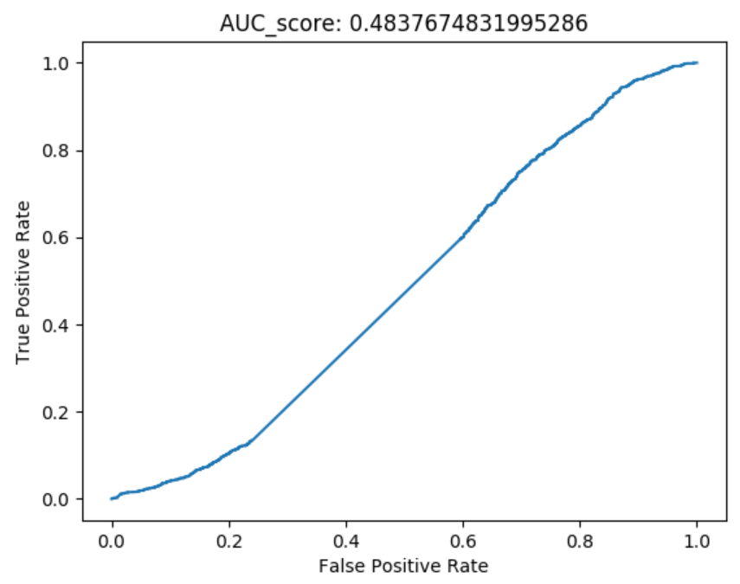
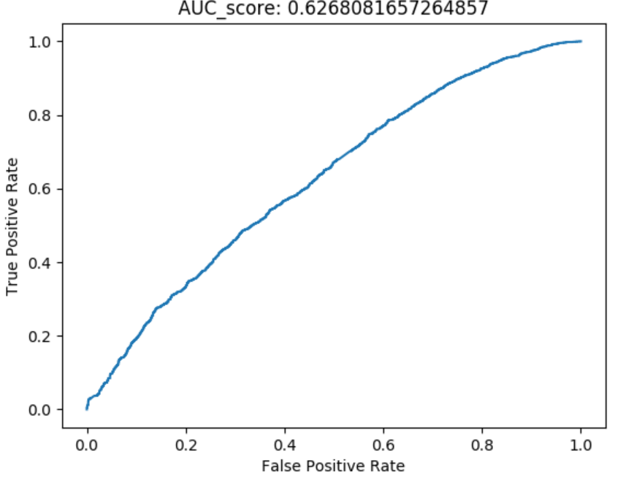
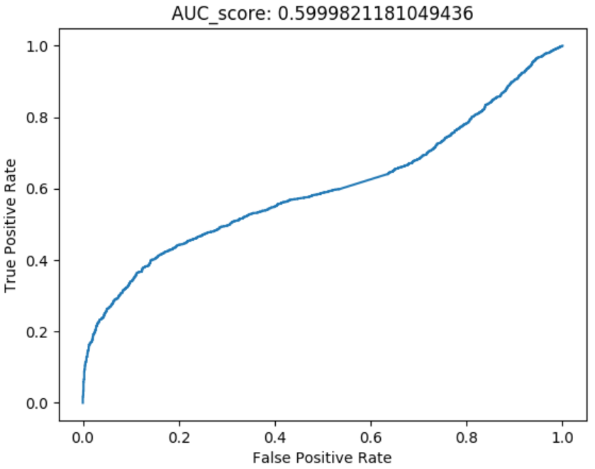
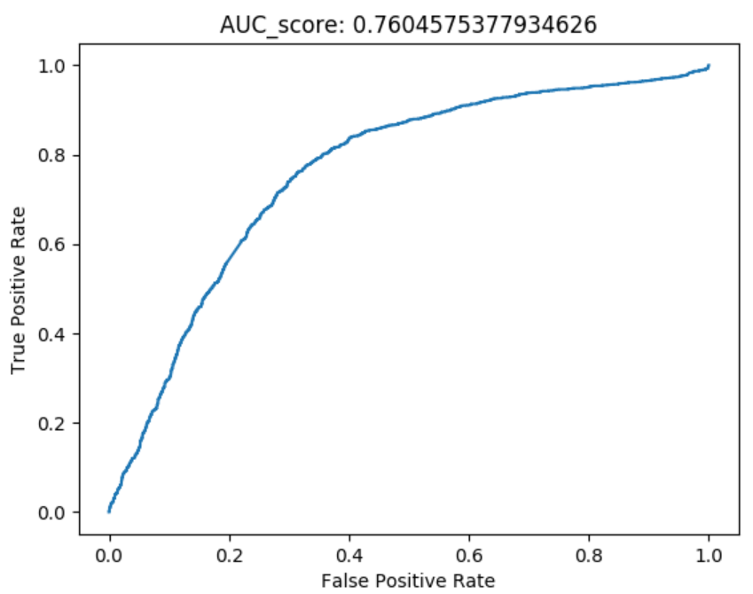

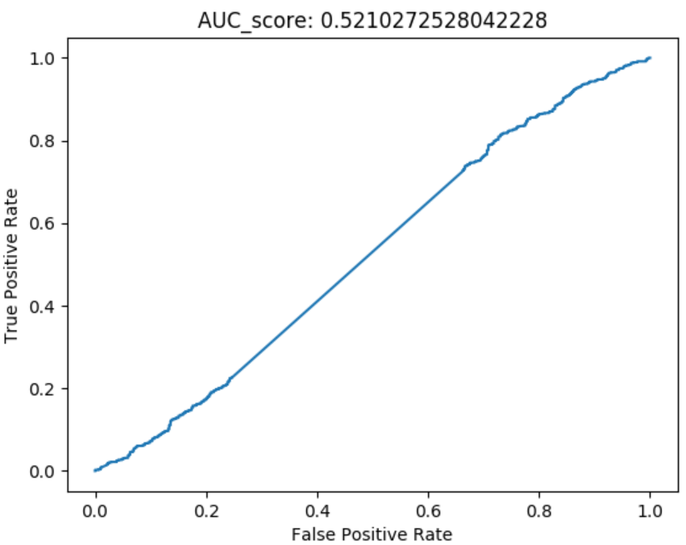
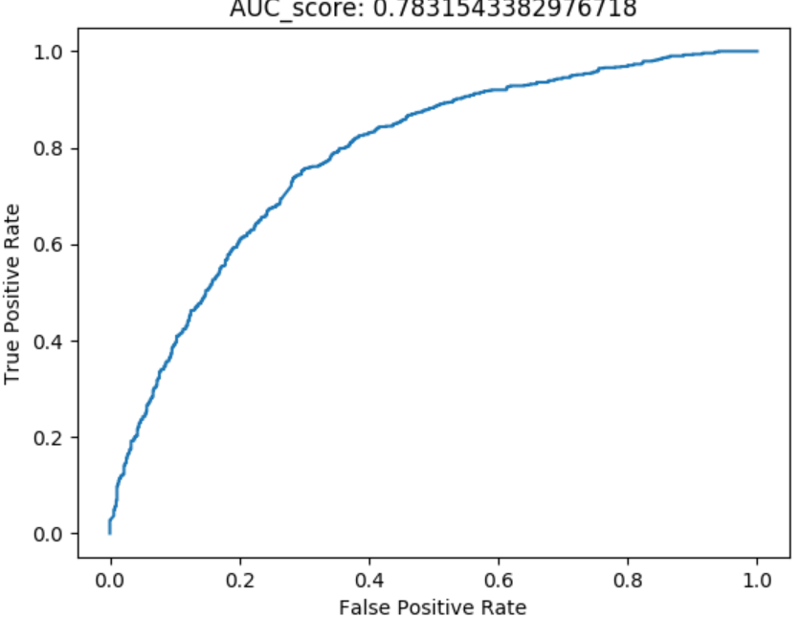
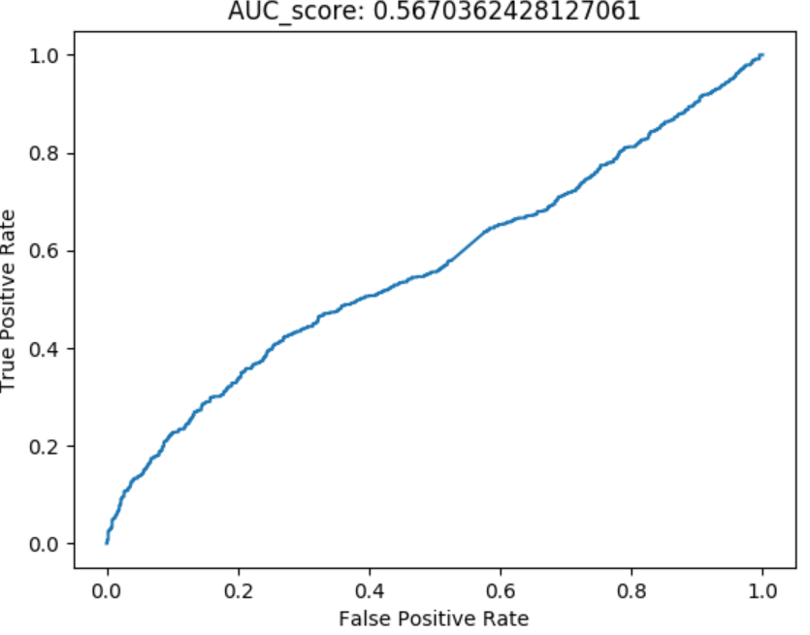
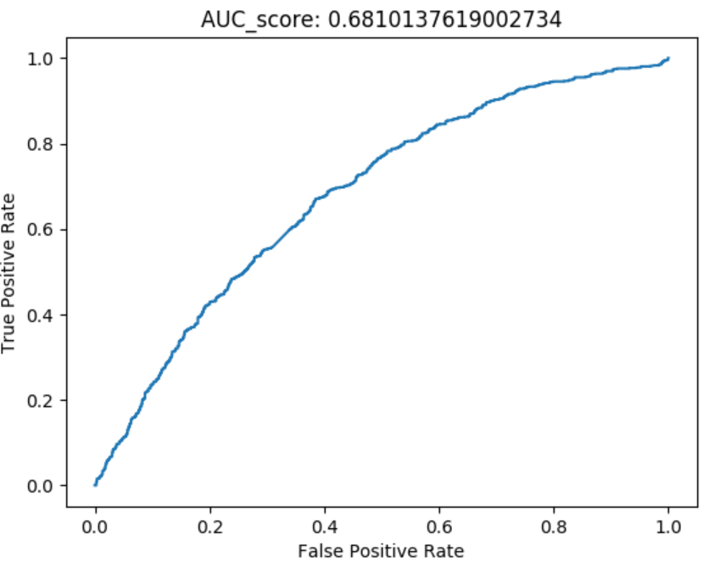
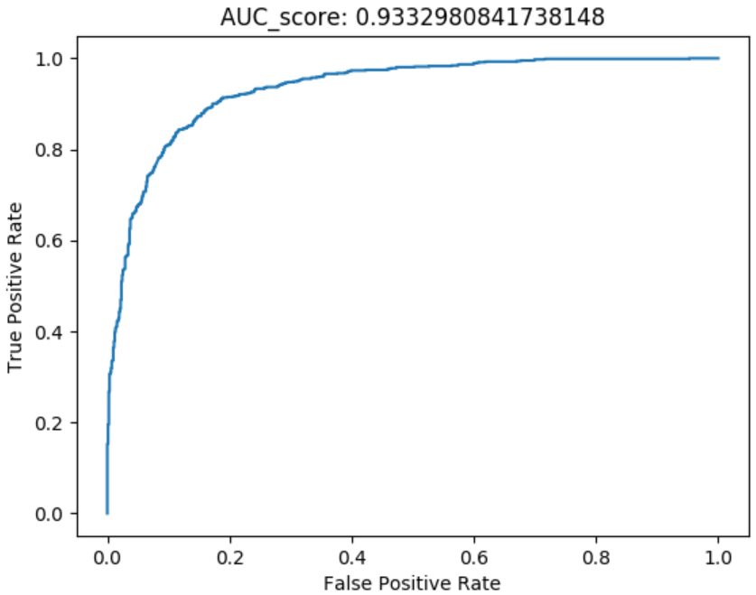
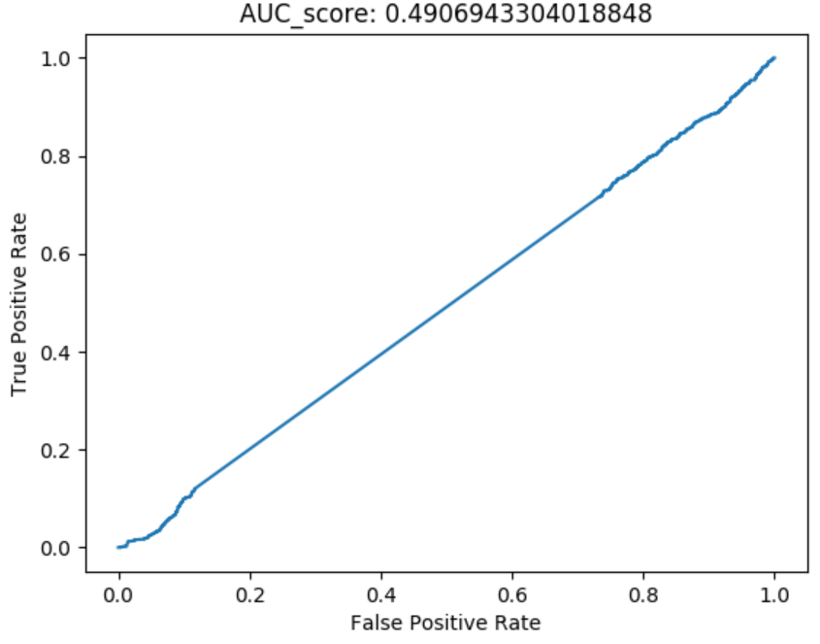
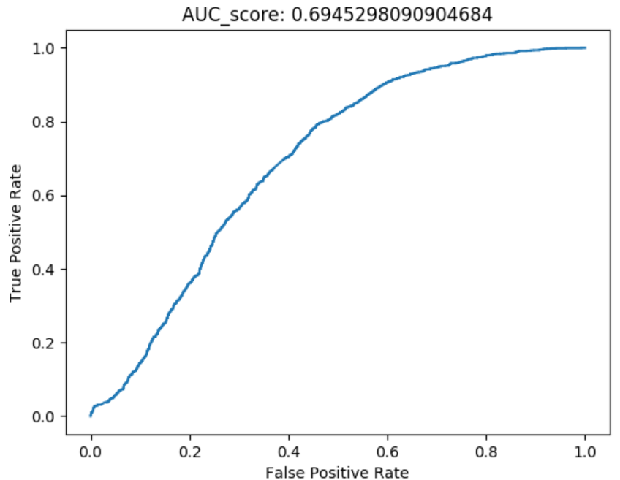
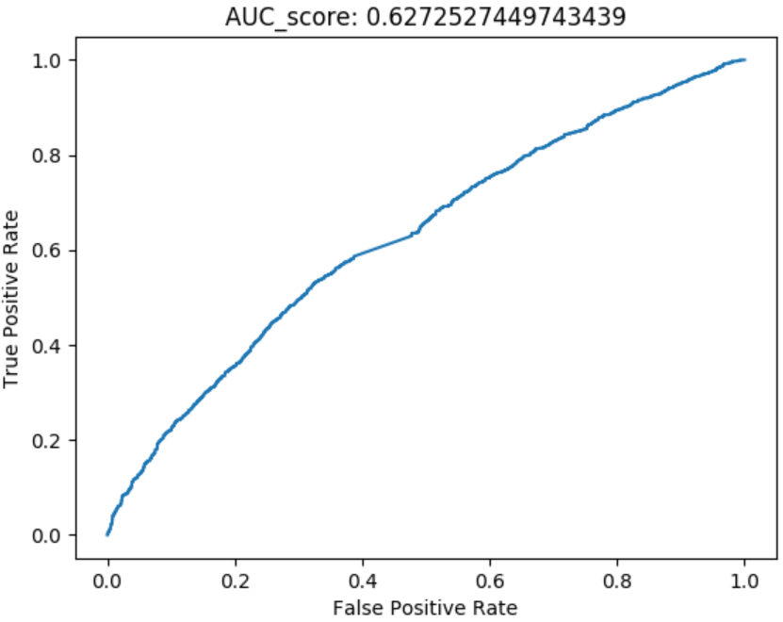
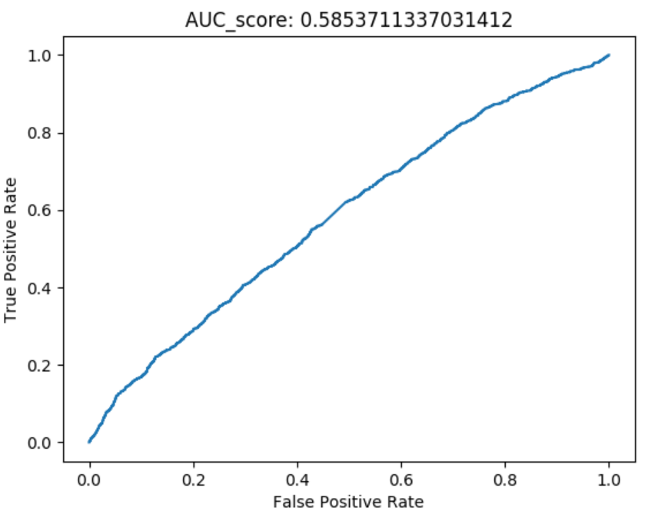
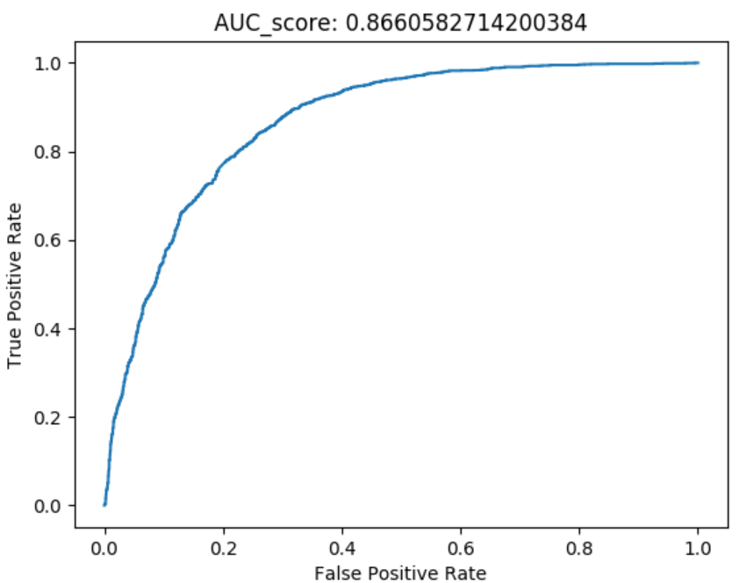
Feature Analysis Sequence = 100 Frame, Overlap = 10 Frame Test Negative: Generated fake videos with Obama mask vs. Other Politician(Hillary)
Head wrt. Camera | Head Rotation | Gaze | Blink | Lips
FaceSwap Fake Videos for Obama
Other Politician (Hillary)
Other Politician (Pompeo)
Other Politician (State Department Officers)

Slide 5
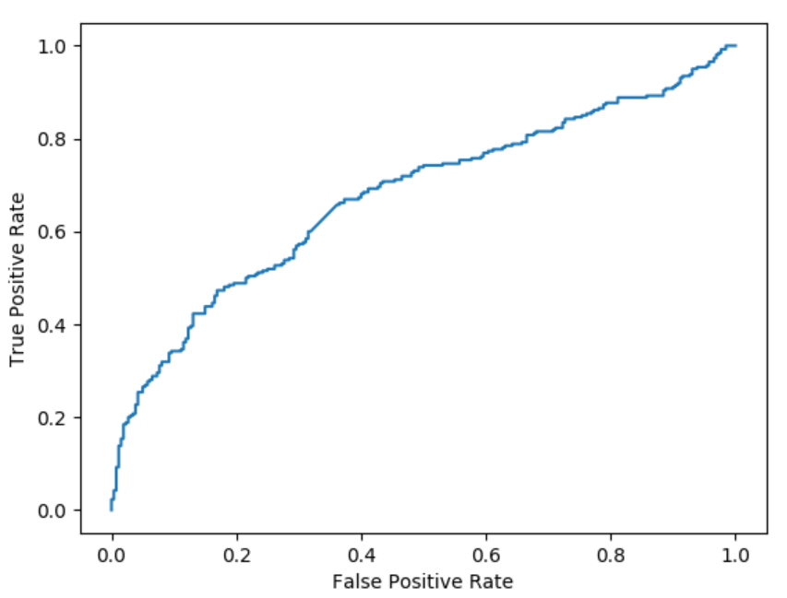
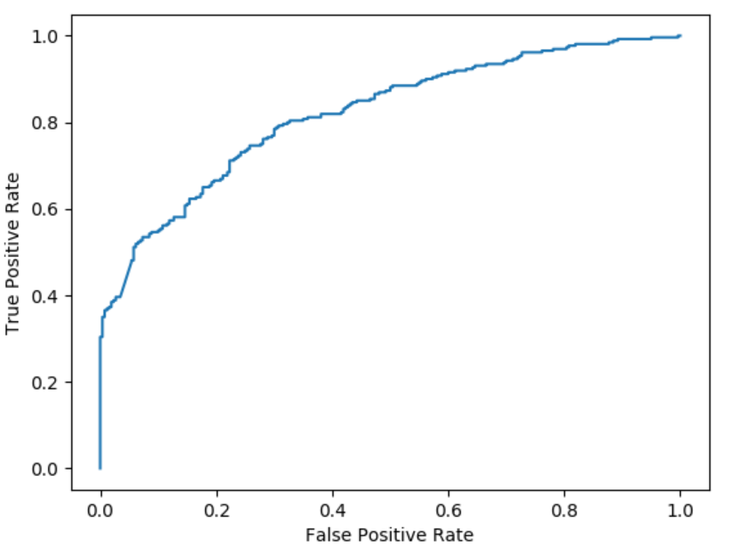
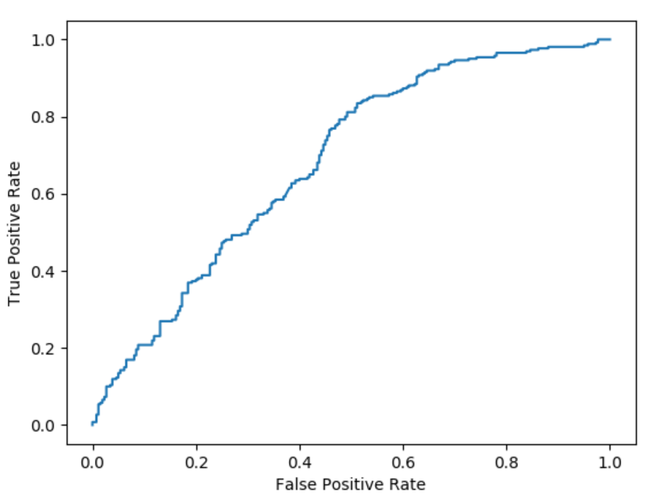
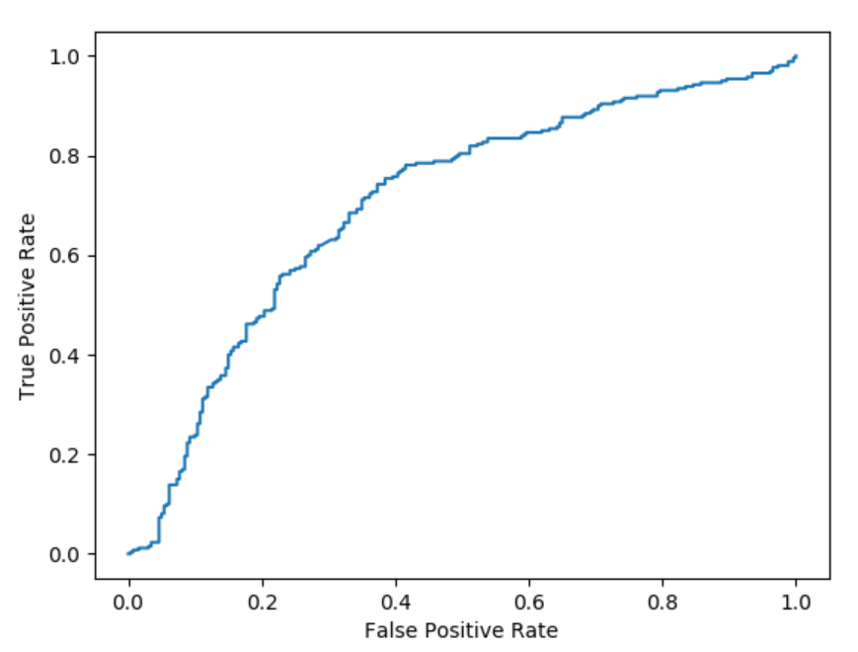
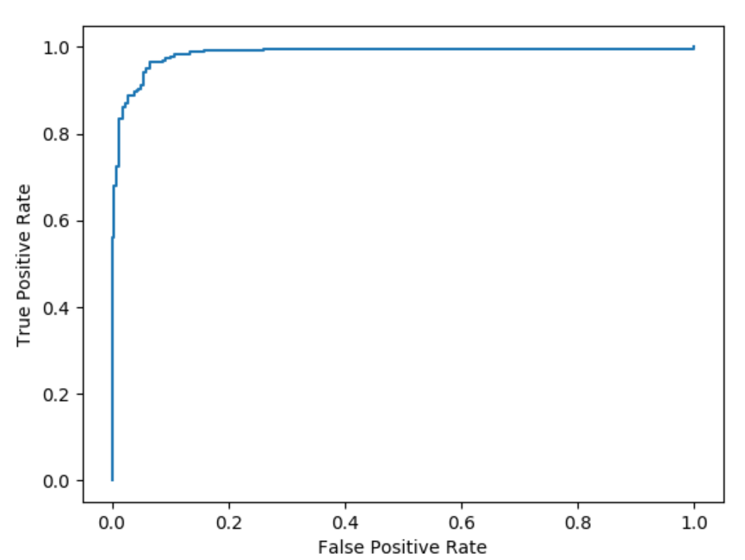
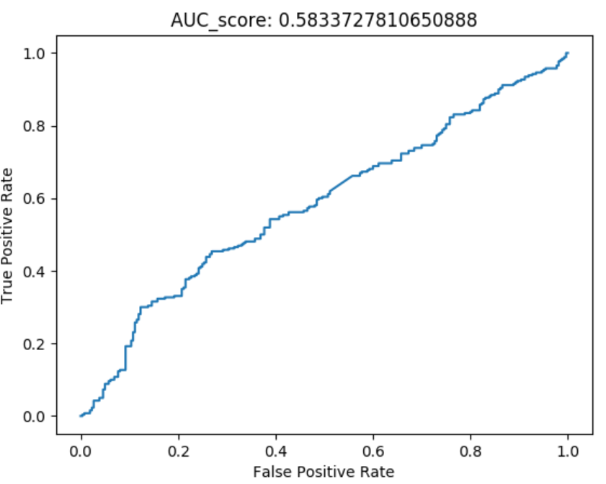
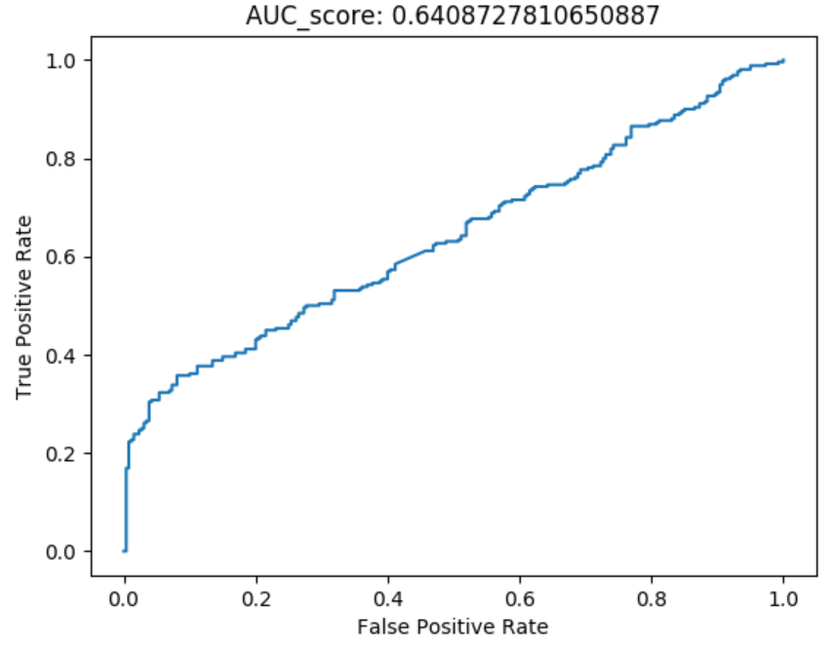
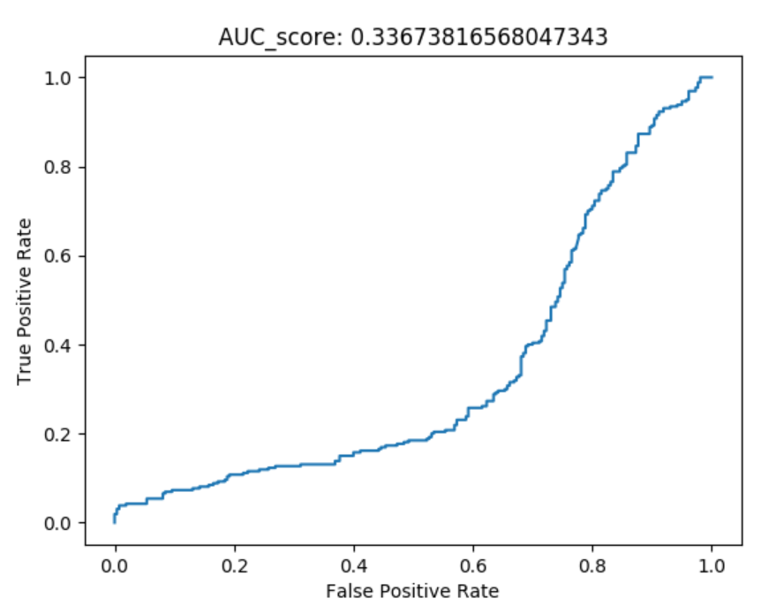
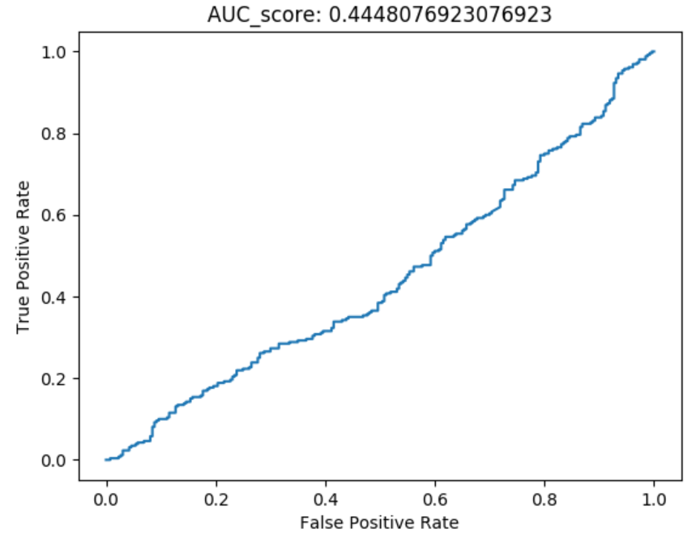
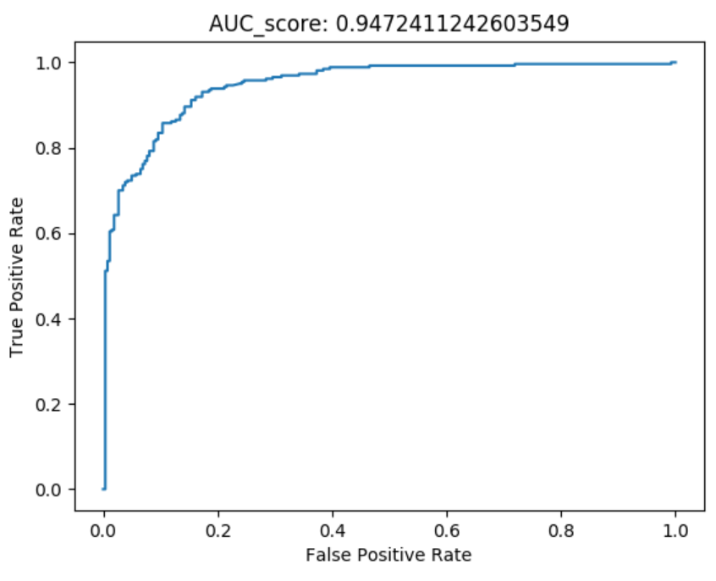

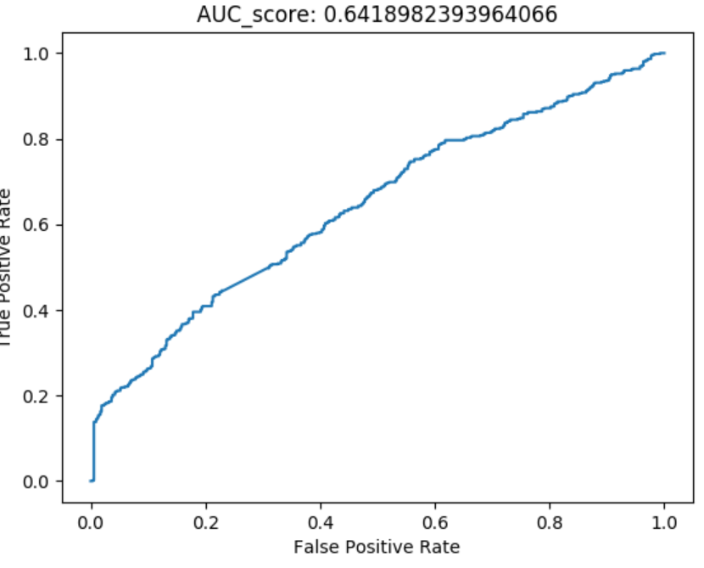
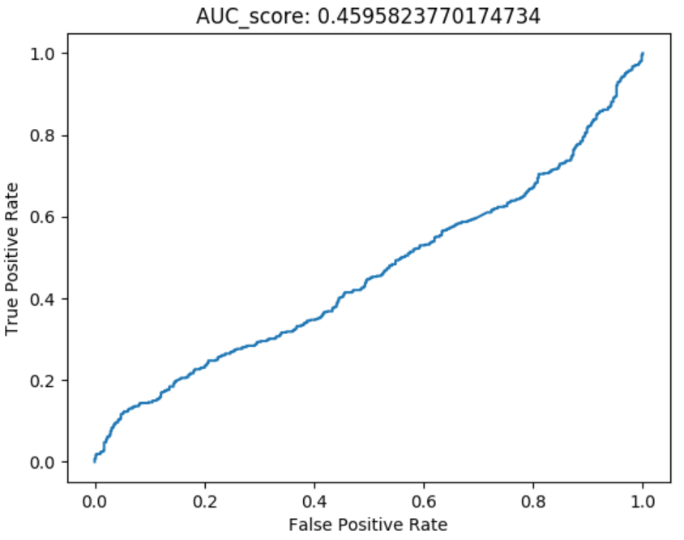
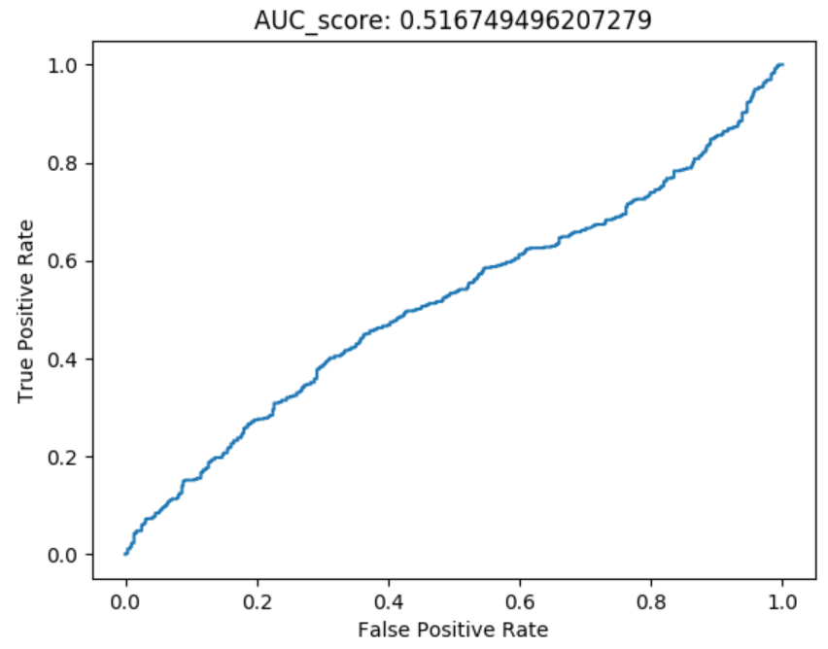
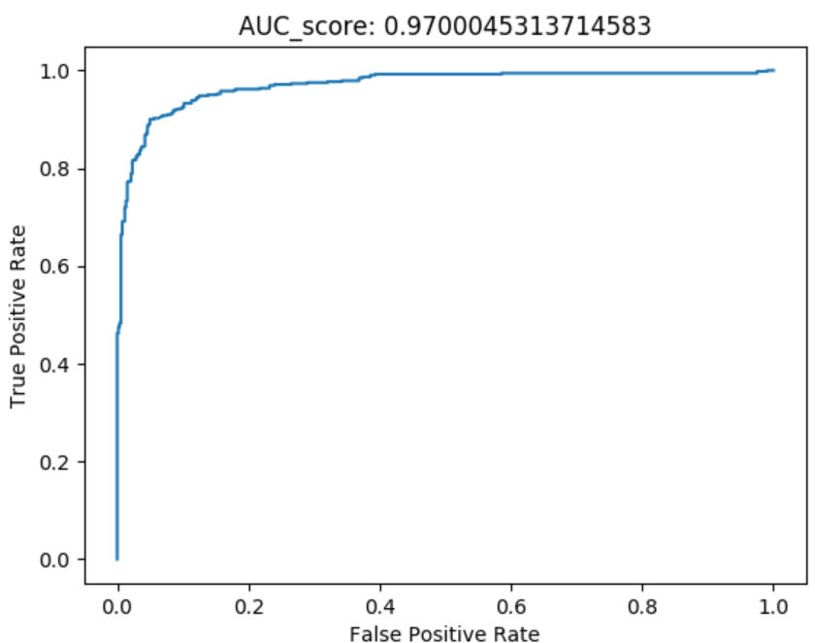
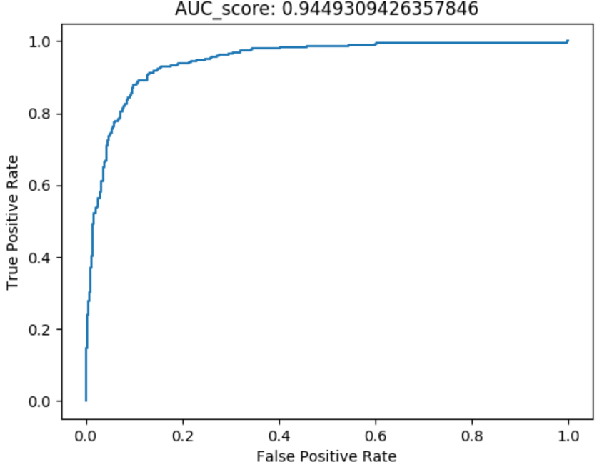
Feature Analysis Sequence = 100 Frame, Overlap = 10 Frame Test Negative: Generated fake videos with Trump mask vs. Other Politician(Hillary)
Head wrt. Camera | Head Rotation | Gaze | Blink | Lips
FaceSwap Fake Videos for Trump
Other Politician (Hillary)
Other Politician (Pompeo)
Other Politician (State Department Officers)

Slide 6
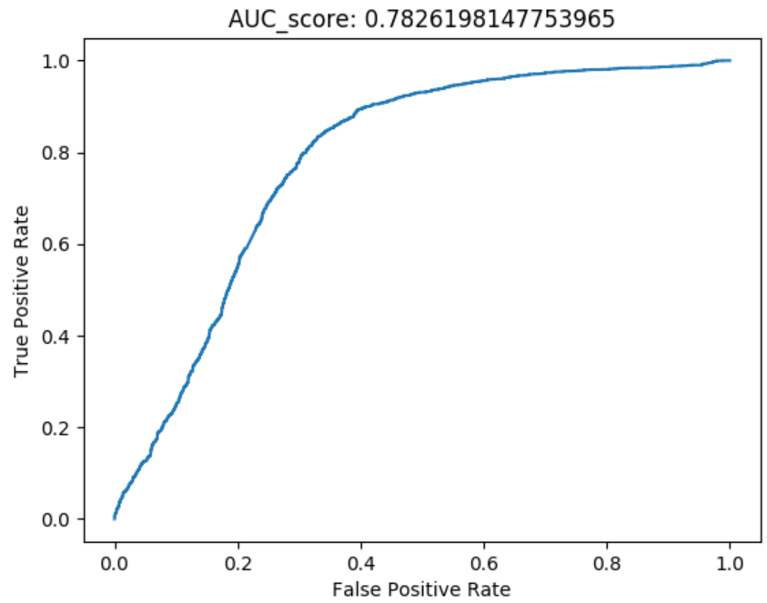
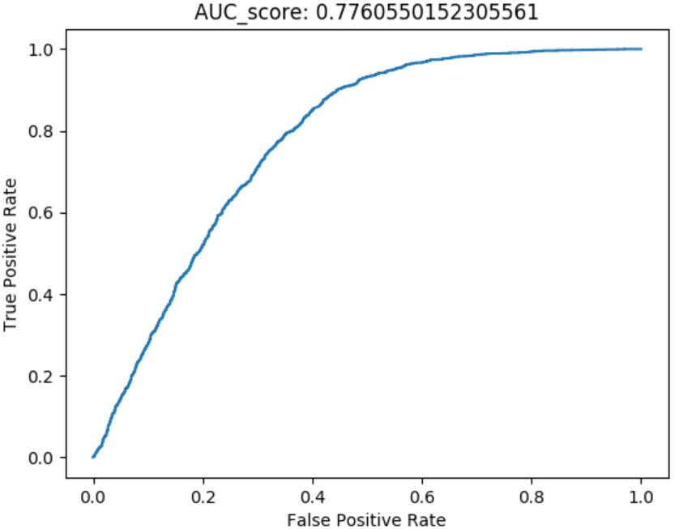
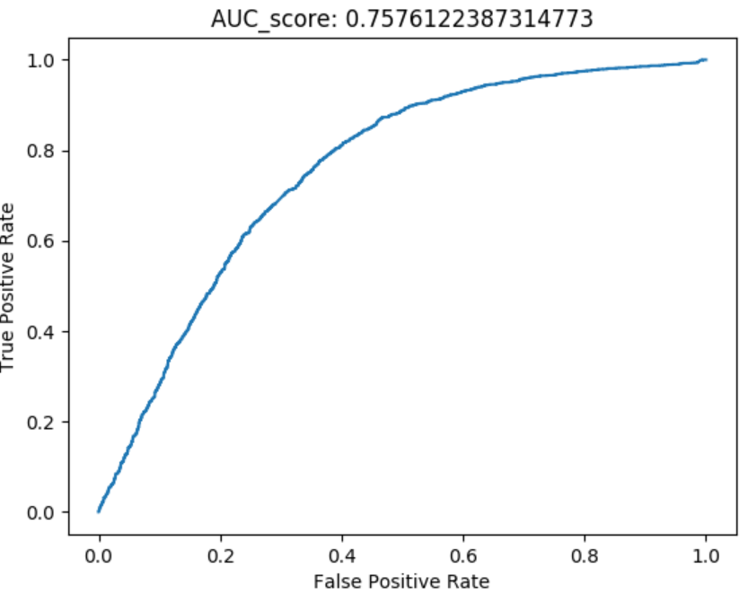
Feature Analysis Sequence = 100 Frame, Overlap = 10 Frame Test Negative: Generated fake videos with Obama mask vs. Other Politician(Hillary)
Gaze | Blink | Lips
Train with Face Forensic dataset
Train with Politician dataset (May, Pompeo, Officials)

